Slide 1
CTO INTERVENTION
UTILITY, HARDWARE AND STRATERGY
M S SHIVENDRRAN

Slide 2
REFERENCES
Eric J Topal , Textbook of Interventional cardiology
Chronic total occlusions : A guide to recanalization – Ron Waksman and Shigeru Saito
Practical Handbook of Advanced Interventional Cardiology – Wiley Blackwell
Manual of Chronic total occlusion interventions ; Emmanouil Bralkis
SCAI : interventional cardiology Review
JACC CTO impact in MI outcomes /Circulation
ESC / AHA guideline on coronary revascularization
Braunwald’s Heart disease, 12 th edition
Interventional cardiac catheterization book, Wiley Blackwel
Guiding principles for CTO PCI- AHA a global expert concensus document

Slide 3
Definition- CTO
100% Occlusion in a Coronary artery
TIMI 0 flow
Atleast 1 months duration
Early chronic 1-3 months
Late chronic > 3 months
Notes:
braunwald-1 month; topal-3 months;
Timi I flow- subtotal /FUNCTIONAL OCCLUSION
PSEUDO OCCLUSION- lesion with residual lumen but without antegrade flow bcz of competing collateral flow

Slide 4
DEVELOPMENT OF CTO
Notes:
Obstruction of coronary artery with thrombus
Thrombus formation develop proximally and distally.
Thrombus develop upto side branch ostium.originally occluded area turns into fibrotic plaque with calcified lesions.
Which gradually hardens over the course of time

Slide 5
Development of CTO
2 weeks → Proteoglycan enriched ECM and myofibroblast infiltration
6 weeks → Negative arterial remodelling and disruption of internal elastic lamina + Neovascularization
12 weeks→ Decreased microvessel formation and CTO perfusion
Gradual replacement of Proteoglycan by collagen and calcium

Slide 6
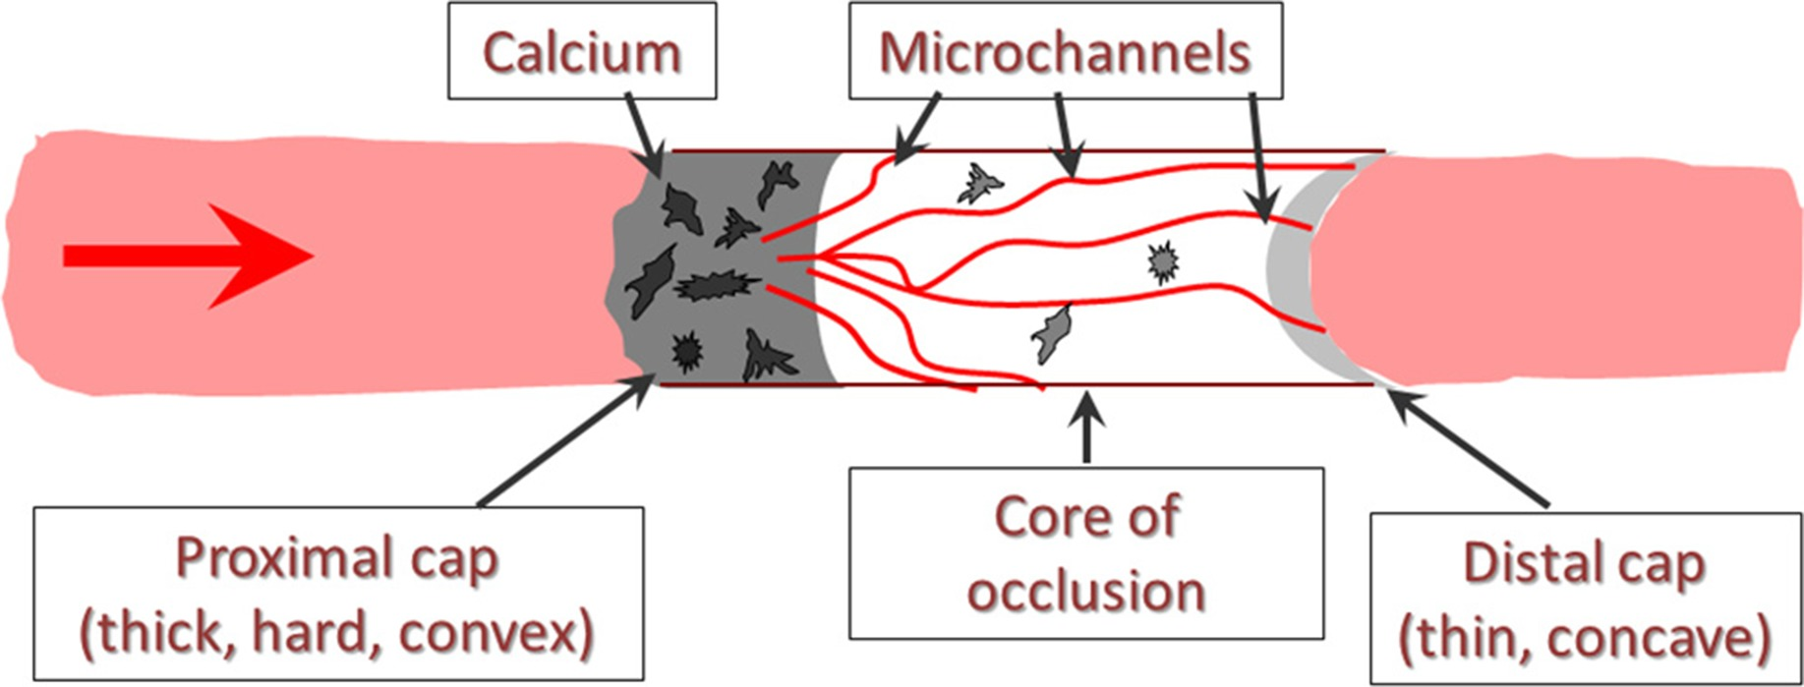
PROXIMAL CAP
BODY
DISTAL CAP
Organized thrombus
collagen, calcium, elastin ,cholesterol cleft , RBCs etc.
Densely packed collagen but
Thinner and softer
Rationale for retrograde approach
Thickened structure- Type I,III, V and VI collagen.
Type IV in calcified tissues
Distinct Physical barrier to access CTO
Notes:
Histopathology of CTO- vessel architecture is preserved- becoz there is continuous supply from vasovasorum.-hence favoring revascularization with CTO techniques
Proximal fibrous cap thicker becoz of exposure to arterial pressure
Body- soft or cholesterol laden lesions- in young cto<1 year
Amount of cholesterol decreases as cto progresses older age cto contains hard fibrocalcific lesions.

Slide 7
AHA GUIDELINE

Slide 8
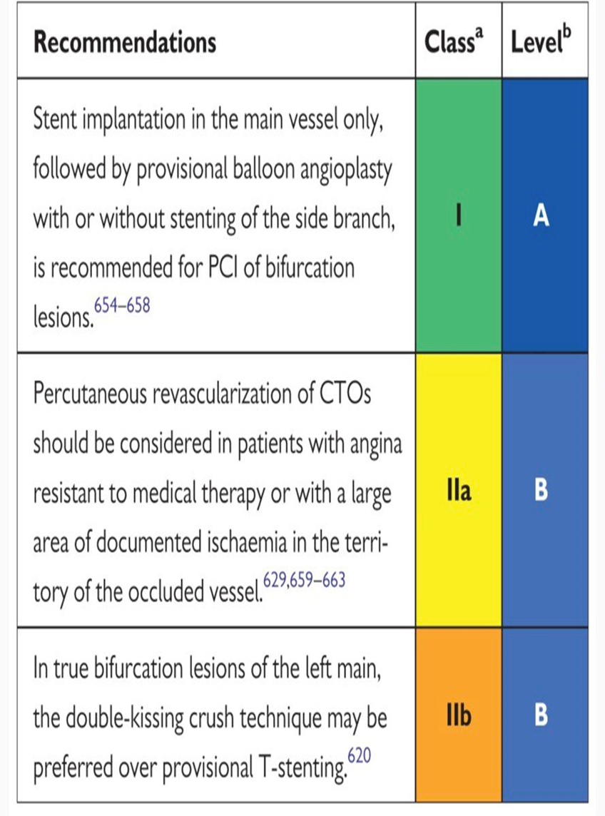

Slide 9
Should CTO be intervened in this patient?
Notes:
Revascularization should be done in patients with angina/dyspnea/ischemia on non invasive testing or lv dysfunction.
Pci- svd or post Cabg (ESPECIALY pts with patent left IMA graft to LAD)- high risk and technical challenges with redo cabg

Slide 10
SHOULD I PROCEED WITH CTO PCI?
Notes:
Deciding when to proceed with CTO PCI depends on the balance of the antici-
pated risks and benefits of the procedure, should be individualized, and should
always be patient-centered.

Slide 11
CTO benefits
Improve quality of life:
Medical refractory angina
Dyspnea + Fatigue
Undiagnosed major depression
Minimizing antianginals
Notes:
2) Pt attribute to aging and may not report them
4) Cost related benefit; ED is a common symptom in cad, pt now can stop nitrates and take PDE inhibitor

Slide 13
DECISION CTO TRIAL
834 patients
OMT vs OMT-PCI
Similar outcomes after 3.1 years
Several limitations
Notes:
EURO cto trial: CTO pci improved some but not all measure of health status. Higher relief of angina in pci group.and at 3 years major adverse cv events and cerebrovascular events were lower in pci group vs omt
Drawback in Decision cto trial was treating non cto pci before randomization and cross over

Slide 14
CTO benefits
Reduce the need for CABG
Complex stable coronary artery disease → CABG
*Less complex disease (Syntax score < 22) → PCI=CABG
PCI →
Patients who Decline CABG for Non medical reasons / Surgical Risk

Slide 15
CTO benefits
Reducing Ischemia
CTO are ischemic even if collateral circulation is present.
CTO PCI benefit in patients with significant baseline Ischemic burden
The Hemodyanamic of donor vessel may improve.
Notes:
Baseline ischemic burden of more than 12.5 % benefit from cto opening

Slide 16
CTO benefits
Improves myocardial Function :
Provided territory is Viable

Slide 17
EXPLORE Trial –
Patient who underwent Primary PCI for ST elevation MI and found to have concomitant CTO in Non infarct related artery
CTO PCI vs Medical management

Slide 18
Prevent Arrythmias:
Ischemia may predispose to Ventricular Arrythmias
Infarct related artery CTO was independently associated with VT recurrence after successful catheter ablation.
Patients with Ischemia induced arrythmias could benefit from CTO recanalization

Slide 19
Notes:
66 male with history of vt storm. Had rca cto.. After pci to rca cto he had ICD and discharged. After 9 months in checkup interrogation revealed he had NSVT but not required the delivery of shock.

Slide 20
Notes:
Although guidelines do not recommend revascularization alone as a treatment of vt, recent studies on revascularization of cto prove that this might actually be the case. Yet we need additional knowledge.

Slide 21
CTO benefits
Improve tolerance of Future coronary events
CTO patients with MI - “Double jeopardy”
Notes:
Pt with a cto and donor vessel has acute occlusion—it is a double jeopardy
But no prospective studies showing Prophylactic PCI can improve the outcomes of future ACS

Slide 24
ESTIMATING LIKEHOOD OF SUCCESS
Notes:
Operator experience and lesion complexity

Slide 28
ESTIMATING RISK?
Notes:
DEATH.MI TAMPONADE STROKE RECURRENT SYMPTOM REQUIRING REPEAT TARGET VESSEL REVASCULARIZAITON

Slide 29
Notes:
Higher chance of Isr because of negative arterial remodelling.
Optimize with ivus.

Slide 30
CTO PLANNING
No to Ad-hoc PCI except in some cases
Time for Procedural Planning
2)Decide on Viability and extent of ischemia of the territory supplied by the occluded vessels.
Coronary CTA -> Facilitate Planning
Notes:
Exception: acs pt with saphenous vein graft disease treatment of native coronary artery CTO is considered as preferred treatment statergy.
Acs resulting in cardiogenic shock, successful use of cto pci techniques can help achieve haemodyanamic instability.

Slide 32
Contraindication to CTO-PCI
Absolute Contraindication:
Contraindication to P2Y12 Inhibitors
Relative Contraindication:
1)Inability to receive Prolonged DAPT
2)Prior Radiation injury to skin
3)CKD
4)HIT (Bivalurudin can be used)
5)Anaphylactic reaction to contrast media

Slide 34
DUAL INJECTION !!
Notes:
Should be performed in all pts with contralateral collateral.. Even in antegrade only cases with no collaterals, retrograde collateral may appear if ipsilateral collateral flow is compromised

Slide 35
Introduce RCA guide catheter first before Left Guide
This prevents guide – guide Interaction
In case of difficult cannulation of left Main, we can introduce stabilizing guide wire into RCA to prevent disengament
Intracoronary / Sublingual Nitratres before injection → Maximally visualize collaterals
Use Low magnification (13 inch)
Notes:
Unimpeded torquing necessary for right coronary artery engament
3) To visualize entire coronary system

Slide 36
Long cine acquisition
Inject donor vessel first → after collateral fill the distal vessel of CTO → Inject occluded vessel.
Use 8 f guide catheter / avoid side hole catheter for angiography
Complex CTO with single donor branch → microcatheter can placed in the single donor branch (for repeated injections into donor branch )
Notes:
3) Good contrast volume and better details of anatomy
4) 1-2ml of contrast for each image shots. Cannot be done if there is multiple branches

Slide 37
ECG and Pressure waveforms during before and after injections
Suboptimal study → cine at 30 fps
To avoid confusion ;
RFA access for RCA / LFA access for LCA
(or)
Right for antegrade and left for Retrograde
Notes:
BIFEMORAL IS BEST FOR COMPLEX LESION . Triple access in case of cabg graft if necessary.

Slide 39
Notes:
lima

Slide 40
ANTICOAGULATION
UF HEPARIN – Preferred Anticoagulant for CTO PCI
ACT >300 s → Antegrade CTO PCI
ACT >350 s → Retrograde CTO PCI
ACT checked every 30 mins
Bivalurudin avoided → Anticoagulant effect not reversed / Risk of Guide thrombosis
GpIIbIIIa antagonist avoided → risk of reopening minor wire perforation

Slide 41
Assessing CTOs

Slide 42
PROXIMAL CAP
Notes:
1) Diffusely diseased proximal vessels can cause pressure dampening upon guide
catheter engagement. If it is a large vessel with collaterals →causes ischemia → small guide catheter, side hole guide catheter , or frequent disengagement
2) Side branches near CTO may hinder antegrade wiring, as guidewires (especially polymer-jacketed guidewires) may preferentially enter
those branches instead of engaging the CTO. Some of those branches could
potentially be used for side branch anchoring to increase guide catheter support.

Slide 43
Notes:
3.6.3 Buddy Wires
BUDDY WIRE CAN BE USED TO ANCHOR WITH HELP OF SUPPORTIVE WORK HORSE WIRE

Slide 44
Notes:
Ambigous proximal cap
If prox- unambiguous –antegrade approach upfront
If ambiguous-> retrograde approach or subintimal techniques
In some cases ; various angiographic angles / ivus can be used

Slide 45
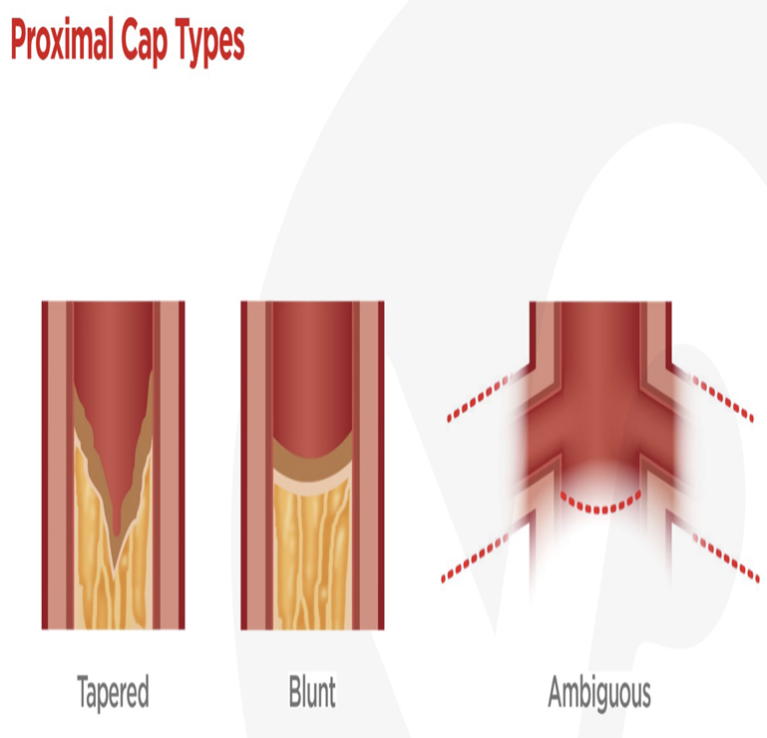

Slide 47
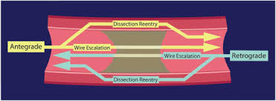
Lesion >20mm → Higher chance of Failure
Lesion >20mm → Dissection and re-entry
Lesion <20mm → Antegrade wire escalation
Notes:
≥20 mm long lesions
may be best approached with a primary dissection/reentry strategy (because
subintimal guidewire entry is highly likely to occur),

Slide 48
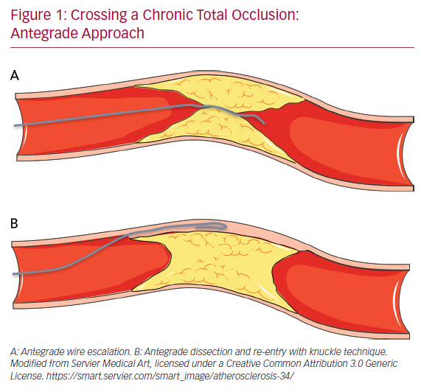
TORTUOSITY
Notes:
Tortuosity increases the chances of guidewire exit and perforation,
hence highly tortuous occlusions may be best crossed subintimally with a knuckled guidewire
less traumatic
,more likely to remain within the vessel architecture

Slide 49
DISTAL VESSEL
Notes:
in bifurcation lesion at distal part-suppose we are doing dissection reentry, reentry may be to one branch compromising the other. Such case we need to proceed with double reentry or retrograde approach.

Slide 50
ASSESSING COLLATERALS
Notes:
Septal collaterals are preferred ,epicardial collateral
perforation can cause tamponade or localized chamber compression in patients CABG,
Septals- shorter ,less tortous route

Slide 51
Notes:
Treatment of epicardial collateral perforations requires occlusion from both
sides of the perforation for successful sealing.

Slide 52
Notes:
1) When advancing donor vessel with significant disease it might cause occlusion. Hence such lesion to be treated first and sufficient time for endothelization before attempting retrograde CTO.

Slide 56
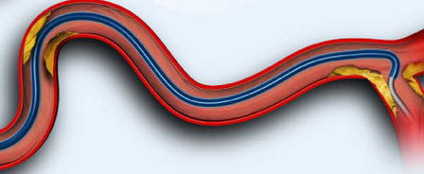
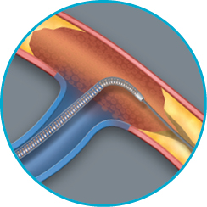
Acute entry angle
SUPERCROSS MICROCATHETER
VENTURE MICROCATHETER

Slide 59
Notes:
1- favorouble entry angle, less collaterals, less tortous.

Slide 60
EQUIPMENTS

Slide 61
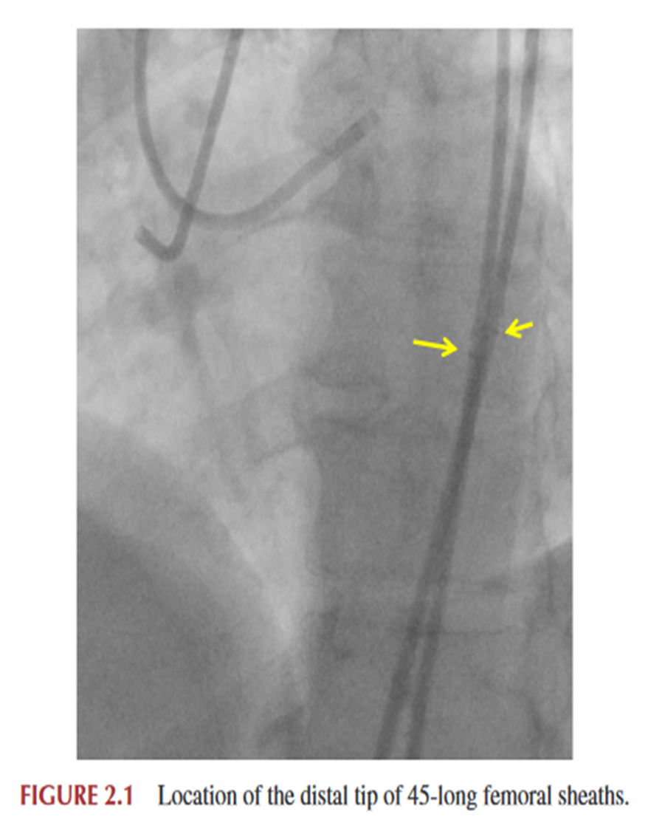
SHEATHS
Femoral Approach
8F , 45 cm
2) Radial approach
Mostly restricted to 6Fr
Sheathless guide can be used
Limitation: Less support
Notes:
Long sheath- better guide catheter and wire manipulation and reducing risk of guide catheter kinking

Slide 62
Guide Catheters
Must-have guides ( Those with supportive shapes)
Left coronary artery -XB and EBU
Right coronary artery- AL
Notes:
90 cm long guide helpful for the retrograde
approach, as it shortens the distance that a retrograde wire needs to cover to
be externalized
80cm guide catheter may not reach coronary osita
Higher length than 90 cm may need longer coronary wires

Slide 63
CTO guide wires
Sion Blue , Samurai
Fielder XT,FC , Pilot 200, Whisper ES
Sion , Confianza Pro 12 , Miracle Bros 12
R350
Work Horse
Polymer jacketed
Open coil
Externalization
Notes:
Workhorse- non polymer hydrophobic./ hybrid hydrophobic/philic

Slide 64
Fielder XT / Fighter – Polymer jacket wire -> Initial antegrade crossing
Gia second and Confianza Pro 12 – Stiff tapered wire -> Course well understood
Pilot – Polymer jacketed moderately stiff non tapered -> Course not understood
Sion – high torquable wire / Fielder FC – Polymer jacketed soft wire -> retrograde
R350 - Wire for externalization

Slide 65
Notes:
Gaia and confianza –High penetration power ---to be used only if course known

Slide 66
MICROCATHETERS AND SUPPORT CATHETERS
Antegrade CTO crossing should always be attempted using an over-the-wire system,
i.e., a Microcatheter or an over-the-wire balloon
Provides better support and increases wire tip stiffness,
b. Can Reshape guidewire tip.
c. Can easily exchange
d. Protects the proximal part of the vessel from guidewire-induced injuries

Slide 67
Notes:
Microcatheter- more flexible , track better and less kinking

Slide 68
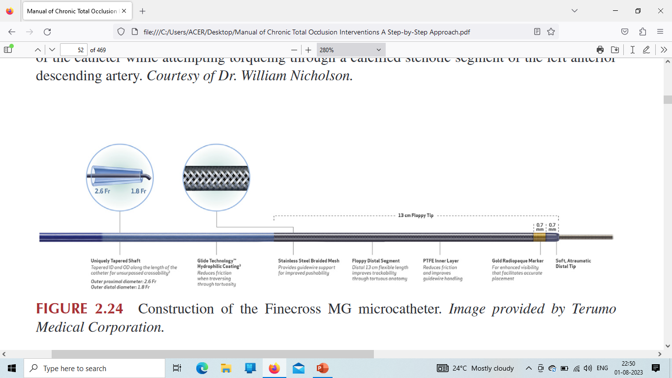
FINECROSS
MICROCATHETER
Navigates well through Tortuous vessels
Notes:
150 cm – retrograde
135 cm - antegrade
Stainless steel braided mesh- increases torquability and kink resistance

Slide 70
TURNPIKE CATHETER FOR
PLAQUE MODIFICATION

Slide 71
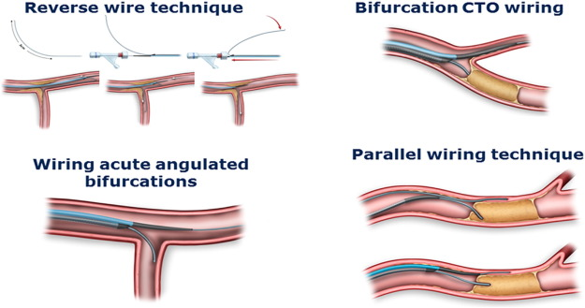
Dual lumen catheter for complex CTO technique
Notes:
Fine duo

Slide 72
Cross Boss catheter

Slide 73
Notes:
Cross boss- 6 F compatible over the wire catheter with a blunt a traumatic tip that is advanced ahead of coronary guidewire into the lesion and rapidly rotated manually using the fast spin technique.
The CrossBoss may be particularly effective for crossing in-stent restenotic
CTOs, as the stent strut may act as a barrier preventing advancement of the
CrossBoss catheter behind the restenosed stent.

Slide 74
Stingray balloon and guidewire

Slide 75
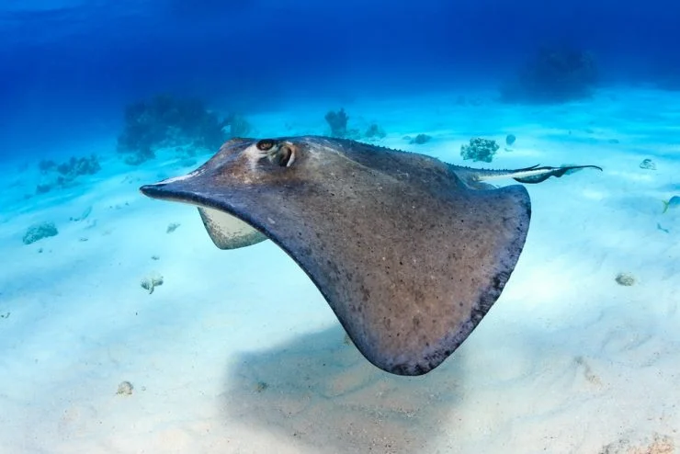
Notes:
Stingray fish- Bottom dwellers and buried in shallows

Slide 77
Snares
Snares are often needed to capture the retrograde guidewire into the antegrade
guide.
Notes:
Three loop snares > single loop snare

Slide 78
Notes:
Retrograde guide wire snaring through antegrade vessel

Slide 79
IVUS – Most commonly used modality in CTO PCI
s

Slide 80
CTO strategies
CTO crossing can occur either through Antegrade or the Retrograde direction
Either By:
True lumen – to – True lumen
Subintimal space f/b re-entry to True lumen
Notes:
term subintimal may increase confusion, as there is typically no
intimal layer within the atheroma of a totally occluded artery. Rather, subintimal
in CTO percutaneous coronary intervention (PCI) is a general term, 1) sub-
intimal, (2) intraplaque, (3) intraadventitial, or (4) combinations thereof

Slide 81
HYBRID APPROACH
Notes:
Wire based- knuckle star- subintimal tracking and reenty last- limited subintimal tracking and reenty

Slide 82
TRUE- TRUE LUMEN

Slide 83
ANTEGRADE WIRE ESCALATION

Slide 85
CTO Techniques
ANTEGRADE APPROACH
RETROGRADE
Single wire:
Sliding / Penetration / Drilling
Double wire:
Anchor wire
Buddy wire
Parallel wire
Seesaw wiring
Knuckle wiring
STAR
Crossboss and stingray
Retrograde wire crossing
Kissing wire technique
Knuckle wire technique
CART
Reverse CART

Slide 86
SLIDING:
Forward movement of polymer jacketed wire.
Aim to track microchannels.
Gentle tip rotation and probing
PENETRATION:
Intentionally steering the wire.
For calcified hard to penetrate lesion.
Use stiff wire
DRILLING:
Controlled rotation
Rotation in each direction less than 90 degree.
Small tip bend is necessary,.
Non polymer jacketed wires used

Slide 89
Notes:
1) knuckle is advanced subintimally through the occlusion.
Compared to trying to advance the tip of a wire, advancing a knuckle is
much faster, safer (the tight loop minimizes the risk of vessel perforation),
and less likely to enter side branches. But now cross boss and stingray is performed.

Slide 92
CTO Techniques
ANTEGRADE APPROACH
RETROGRADE
Single wire:
Sliding / Penetration / Drilling
Double wire:
Anchor wire
Buddy wire
Parallel wire
Seesaw wiring
Knuckle wiring
STAR
Crossboss and stingray
Retrograde wire crossing
Kissing wire technique
Knuckle wire technique
CART
Reverse CART

Slide 93
Balloon uncrossable lesions:
Small calibre balloon 1.2-1.5mm
Threader micro dilation catheter
Micro catheter for balloon uncrossable lesion
Excimer laser coronary atherectomy
Rotational / Orbital atherectomy
Cutting and scoring balloon
Notes:
Most common cause of failure of cto pci- not crossing the guidewire
2nd is balloon uncrossable lesion.

Slide 94
Lesion crossed?
Sudden spontaneous freedom of wire tip →True distal lumen
Exchange with workhorse wire
Contralateral injection . Best Method

Slide 95
Lesion not crossed?
Stop the procedure
No wire success in 60 minutes procedure time or 30 minutes fluro time
No balloon success in 2 hours procedure time or 60 minutes fluro time
Dye limit crosses 400 ml in Patient with normal RFT

Slide 96
Failed CTO ?
Reattempt after 2-4 weeks
Immediate switch / after 2 week switch to retrograde technique
Make use of higher expertise

Slide 99
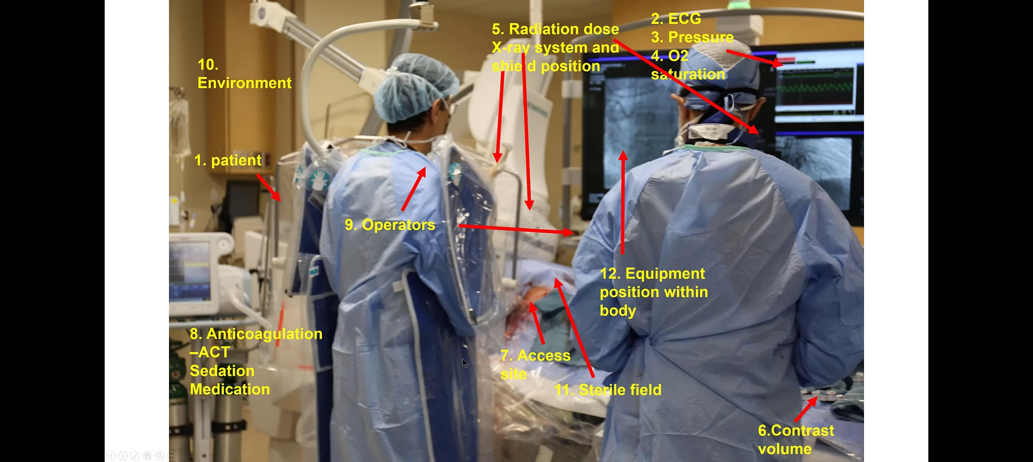
THANK YOU

